Slide 1
Parts of a computer
By Zachary Ballard

Slide 2
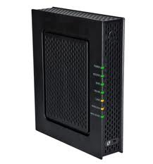
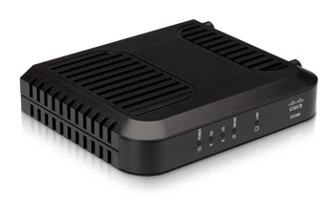
Modem
This device will transmit information to the computer
Outside of the computer

Slide 3
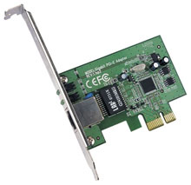
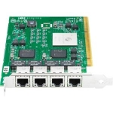
Network Card
Links data to the computer
Motherboard

Slide 4
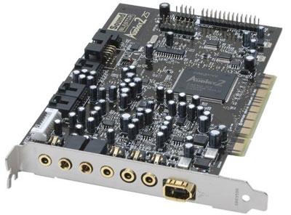
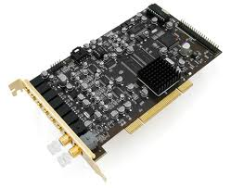
Sound Card
It programs the sound out of the device
In the Motherboard

Slide 5
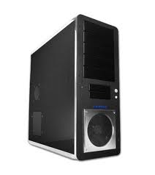
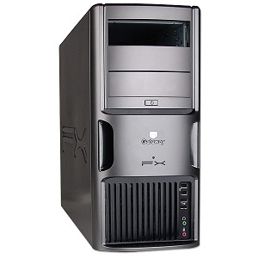
Case
The casing around the computers technical devices
Outside of the computer

Slide 6
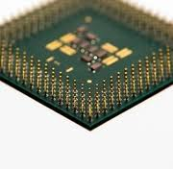
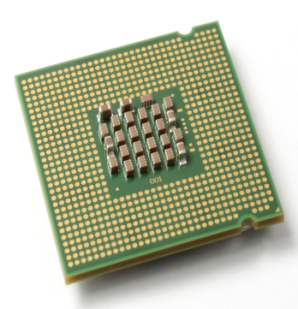
CPU
The main instrument in a computer that has most data
Mother board

Slide 7
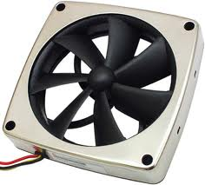
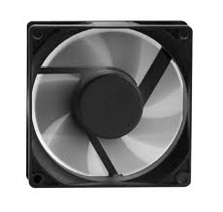
FAN
It keeps the inside of the Computer cool
Inside of the computer

Slide 8
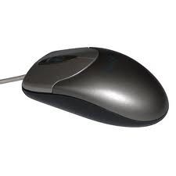
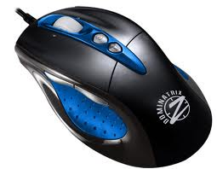
Mouse
Moves the cursor to select Icons on the computer scream
Outside of the computer

Slide 9
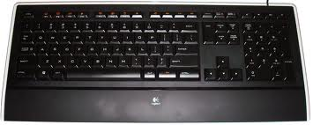
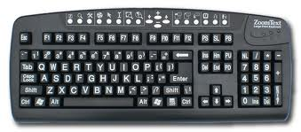
Key Board
Has letters and numbers on a board so you can type and have words show up on the screen
Outside of the computer

Slide 10
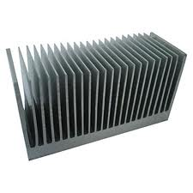
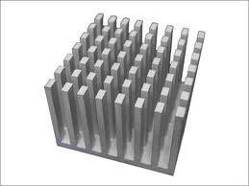
Heatsink
Helps cool it down Inside the computer
Inside

Slide 11
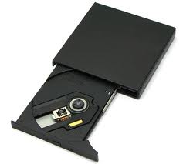
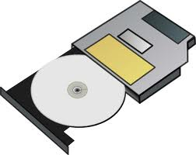
CD Drive
Holds the CD and puts it into the device
Sometimes Outside sometimes Inside

Slide 12
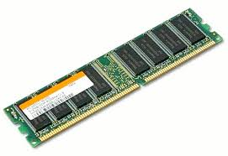
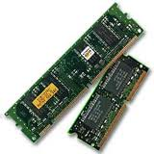
RAM
Random Access Memory
Mother Board

Slide 13
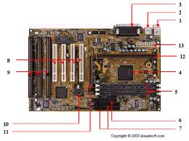
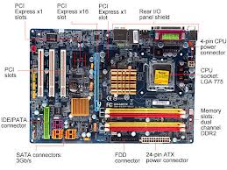
Mother Board
The main Network device in the computer
It is the Motherboard

Slide 14
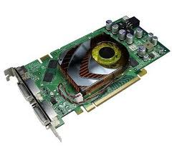
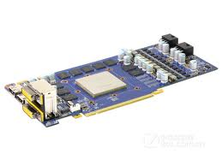
Graphics Card
Controls the graphics
In the Motherboard

Slide 15
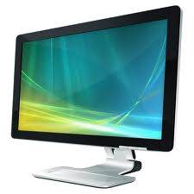
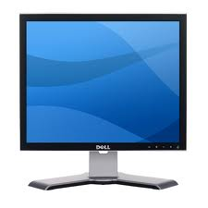
Monitor
The screen on the computer that shows what you are doing
Outside of the computer

