Slide 1
The Boston Marathon Bombing
By: Zachary Ballard

Slide 2
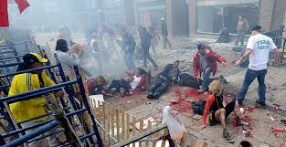
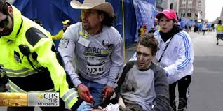
Summary
There were 3 deaths due to the bombs
140 people were injured to the bombs and a lot had severed limbs
There were four bombs, two exploded near the finish line and two didn’t explode
A library caught fire just a little down the road
Obama gave out press conferences to give comfort to Boston citizens

Slide 3
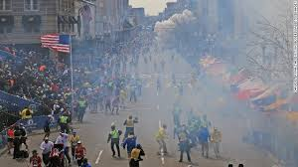
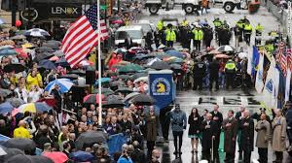
Why I chose this.
I chose this because I didn’t know much on the topic and it sounded interesting.
I also wanted to know why the bombers did that to those people
I am glad I chose it because I found out what I wanted to.

Slide 4
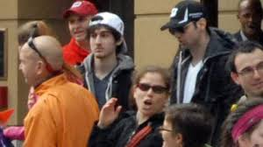
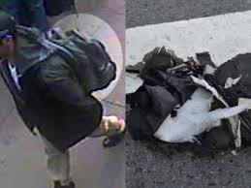
What I learned
The two bombers were Muslim brothers (Tamerlan Tsarnaev and Dzhokhar Tsarnaev)
They left the bombs in backpacks full a shrapnel
They looked up how to make the bombs on the internet
One brother died in a shoot out and they other was found in a boat with note declaring his hate for America

Slide 5
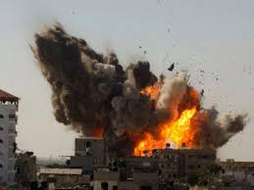
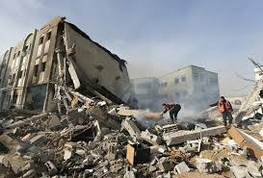
Relevance
The two bombers were angry at America for their influence in the Israel war
Although they were not connected to any terrorist groups
America sold a billion dollars worth of weapons into the war
The war on Israel contributed to this bombing
Along with America’s ‘help’ in the Israel war
If America didn’t intervene in the middle east, this may not have happened

